Slide 1

Robogripper challenge
Group 5
Samuele, aleksander, thijn, dijm
Adaptive robotics september 2025

Slide 2
Context & Assignments
Design a gripper that attaches to a Universal Robots Manipulator tooling hinge.
Take into account pre-determined constraints
Write scripts for the manipulator to execute actions

Slide 3
Modeling
Development and design made in SolidWorks
Many iterations available for viewing on github
The "Camera shutter mechanism" was the starting point of the development

Slide 4

Firmware
Arduino one controller developed with C++
Schematics developed with KiCad

Slide 5
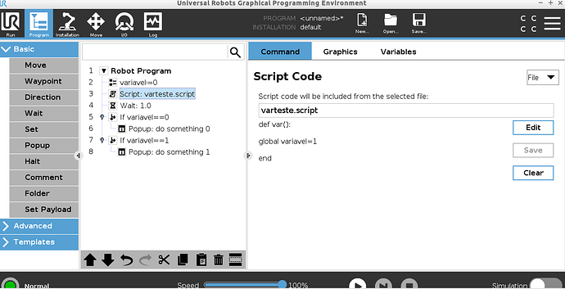
URS SCripts
Scripts developed using URSL (Universal Robots Script Language)
Polyscope utils

Slide 6
Reflections
Missing force sensors: what would happen in a production environment?
- Product damage / scraps
- Tool damage over time
- Is not adaptive

Slide 7
Conclusion
What went good:
It was fun to come up with different ideas and work on them
What went bad:
We should have had a more organized work process, as we encountered many issues at the end.

Slide 8
Q&A
Questions?

